Slide 1
IPL Analytics
End-to-End BI & Advanced Cricket Analytics

Slide 2

Introduction
This project delivers a corporate-grade end-to-end analytics solution for IPL performance and business insight.
It combines data ingestion, cleaning, advanced SQL, analytics modeling, and an interactive BI layer to generate actionable insights and stakeholder-ready dashboards for teams, managers, and analytics partners.

Slide 3

01
Project Overview

Slide 4
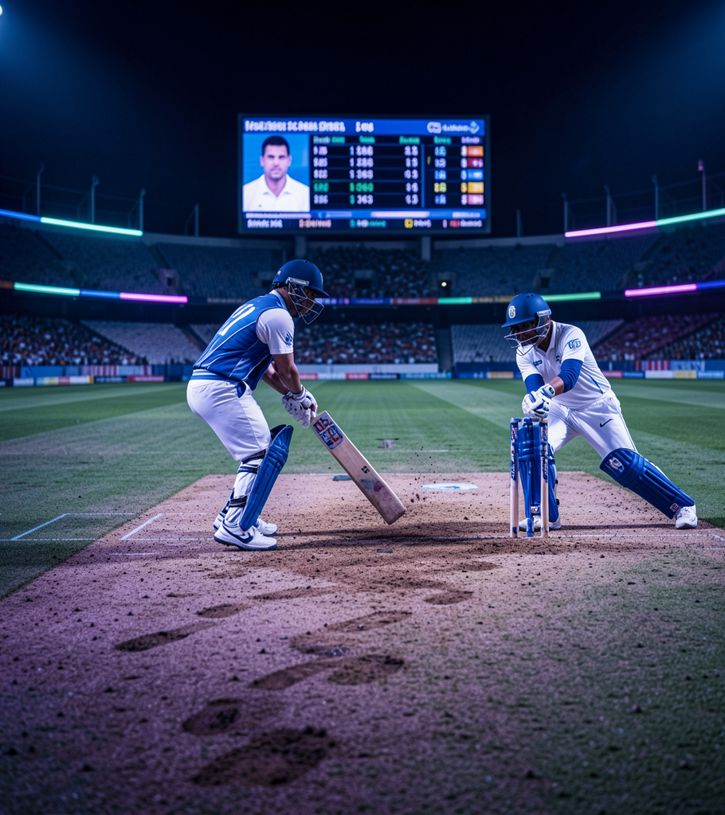
Objective & Scope
Build a complete analytics pipeline to optimize team strategy, player evaluation, and venue decisions.
Scope includes ball-by-ball and match-level analysis, KPI definition, SQL-driven metrics, and dashboard deployment to support data-driven decisions.

Slide 5
Workflow & Technology
Data pipeline: ingestion → cleaning → EDA → advanced SQL
Core tools: Python (Pandas, NumPy, Jupyter), MySQL reporting and stakeholder visualization.

Slide 6
Business Value
Deliver a unified data-to-decision platform that reduces scouting time and informs match strategy.
Provides revenue uplift via enhanced fan engagement insights and cost savings from optimized player utilization.

Slide 7
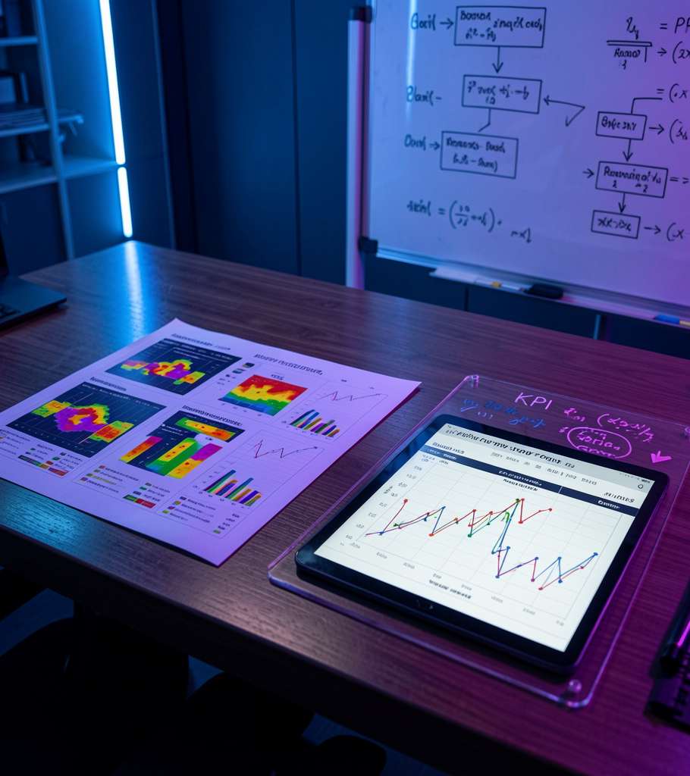
02
Analytics & Outcomes

Slide 8
EDA & SQL Insights
Comprehensive EDA uncovers patterns: win percentages, venue effects, and toss impact.
Advanced SQL (CTEs, window functions) produces repeatable metrics for rankings and situational KPIs.

Slide 9
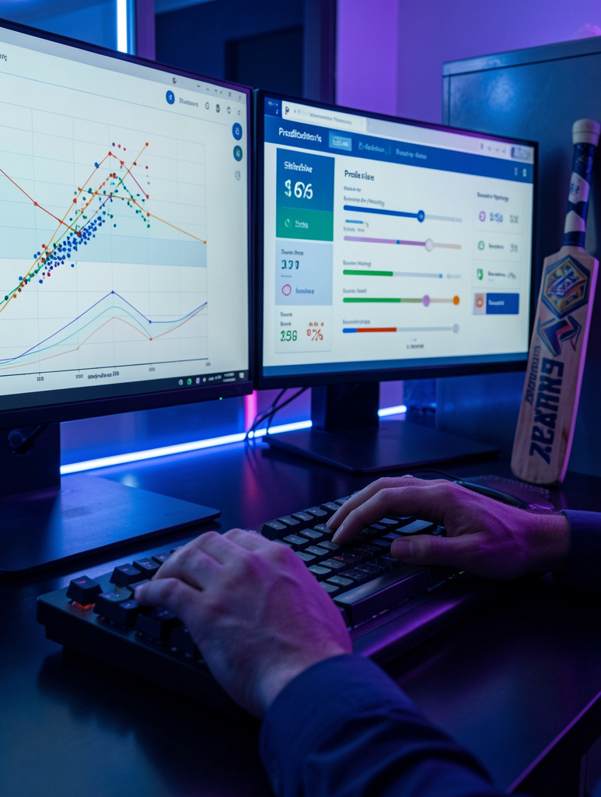
Advanced Cricket Models
Modeling focuses on powerplay vs death performance, batter–bowler matchups, and pressure metrics.
Includes feature-engineered inputs for strike-rate, boundary dependency, and situational form.
Produces model-ready datasets for predictive and prescriptive analytics.

Slide 10
Conclusions
The project delivers a production-ready BI pipeline: clean data, advanced SQL metrics
Enables data-driven strategy, scouting improvements, and commercial insights for teams and partners.
Positions the organization for future ML enhancements and live analytics capabilities.

Slide 11
THANKS!!!!

